Slide 1
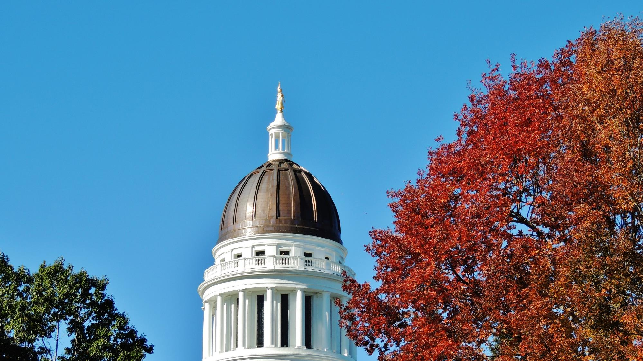

Hannah Pingree, Director &
Co-Chair, Maine Climate Council

Slide 2
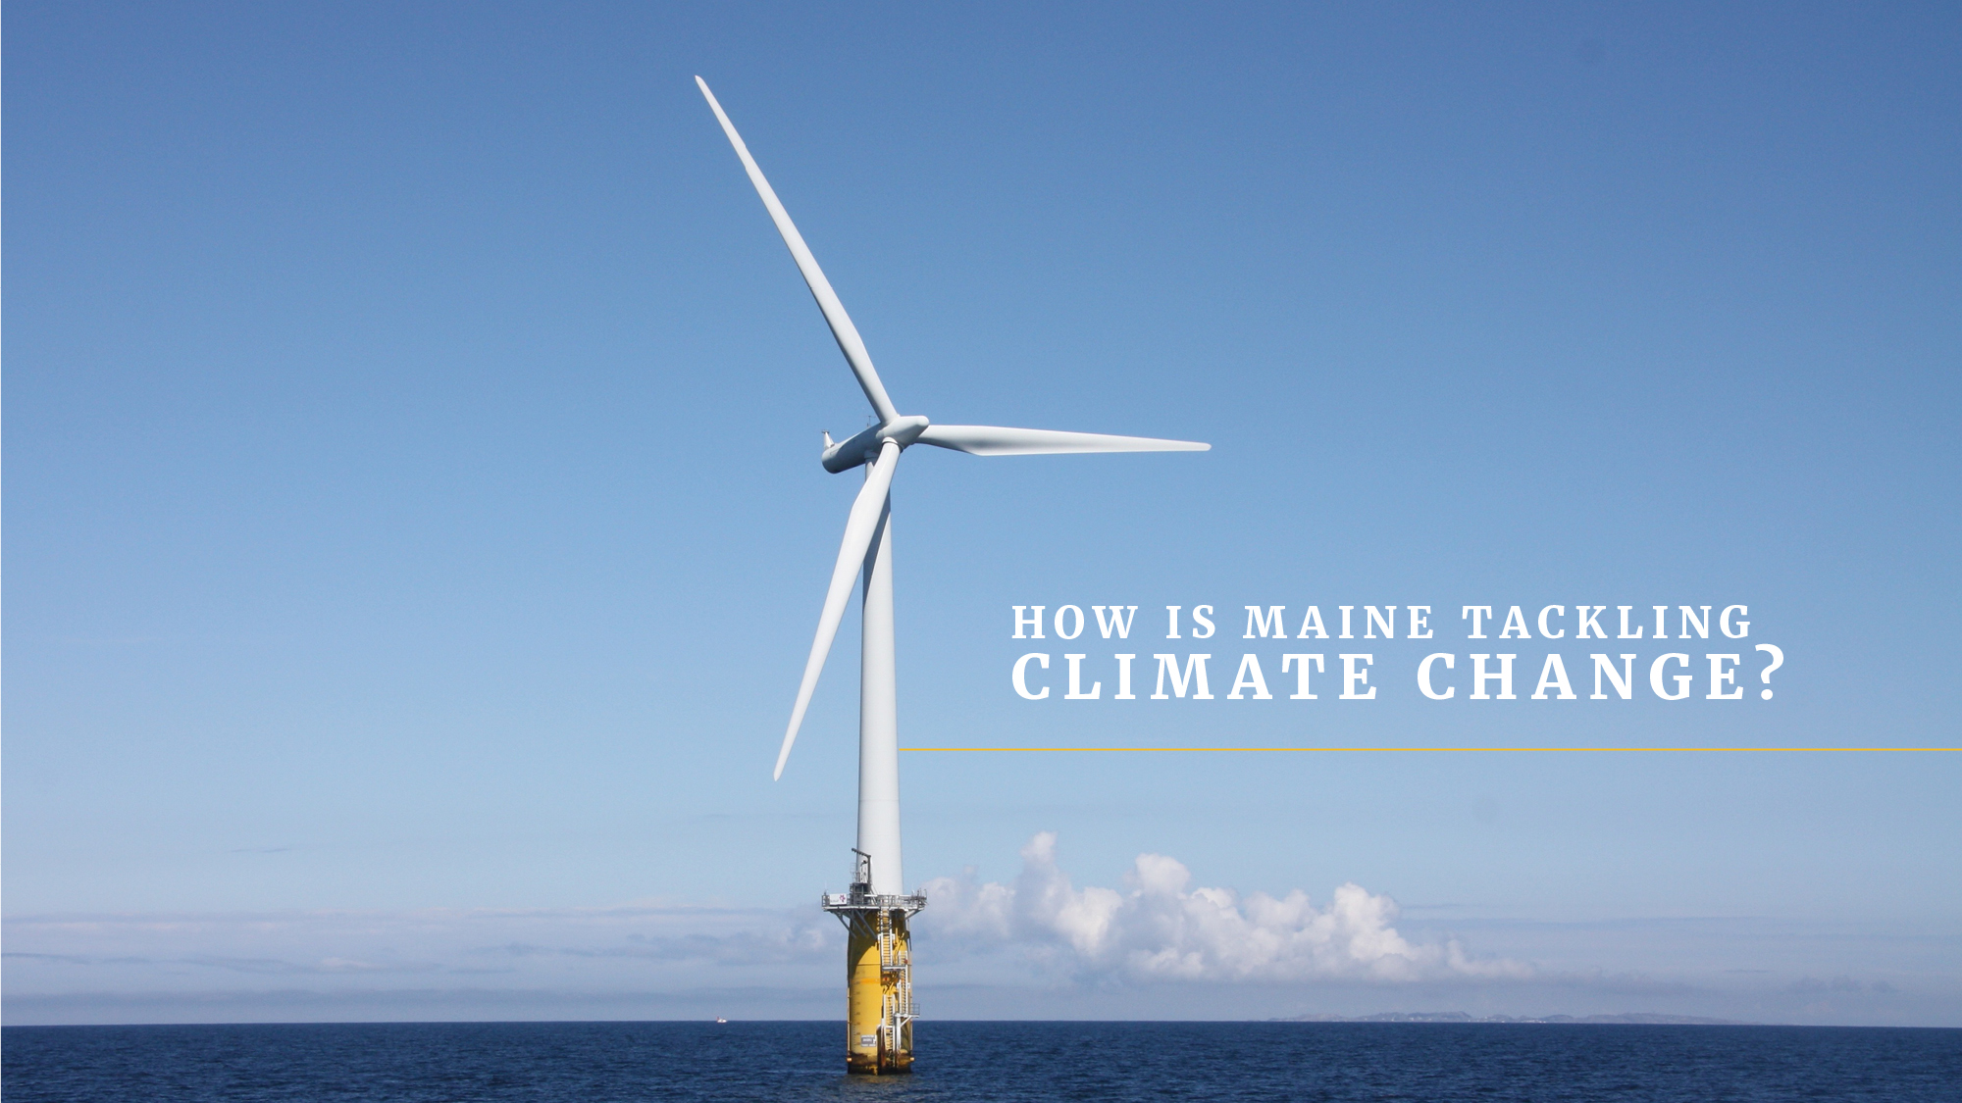
Notes:
We’re here today to talk about climate change but I first want to acknowledge the COVID-19 crisis we are facing in our communities and as a nation.
The pandemic is front of mind for all of us and it can be tempting to push climate to the back burner.
COVID-19 is not the result of climate change. But is it a tragic example of the kinds of multiple, overlapping crises that communities and states will face in a climate-altered world. These crises cannot be ignored and neither will be solved without collective action.
Furthermore, like COVID-19, climate change has outsized negative impacts on people with the least means to protect themselves, especially poor and marginalized communities.
The Climate Council is tasked with ensuring that our most vulnerable communities are prioritized and the benefits of new policies or programs are equitably distributed

Slide 3
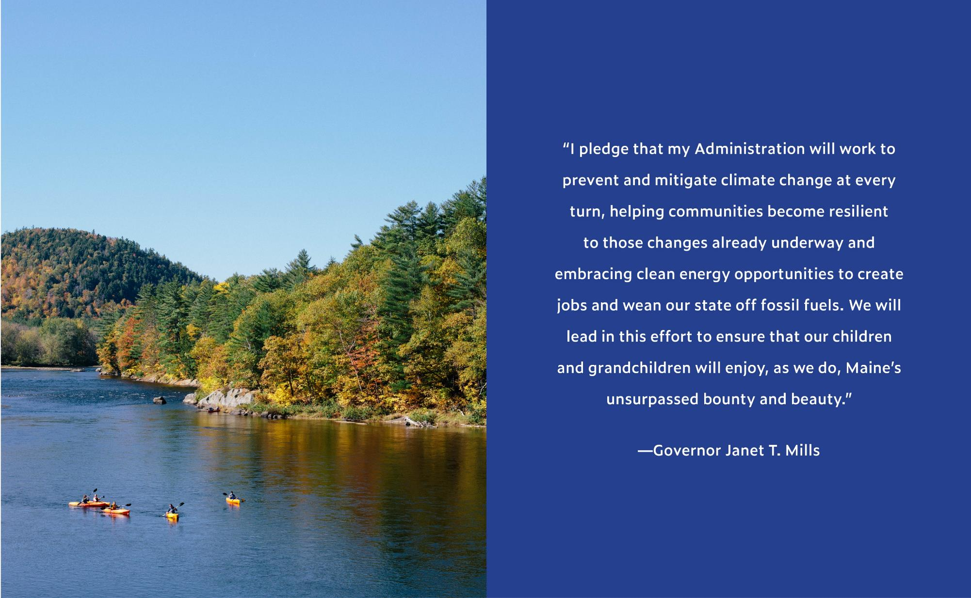
Notes:
When Gov Mills came to office, she made tackling climate change a priority for her administration
Tasked GOPIF with leading the state’s efforts.
But we cannot do it alone
So we are fortunate to have really dedicated partners
like …
in key offices around state government and the private sector.
Our office also works on the opioid response, workforce development and economic recovery, and children’s issues… all of which are profoundly affected by COVID-19.

Slide 4
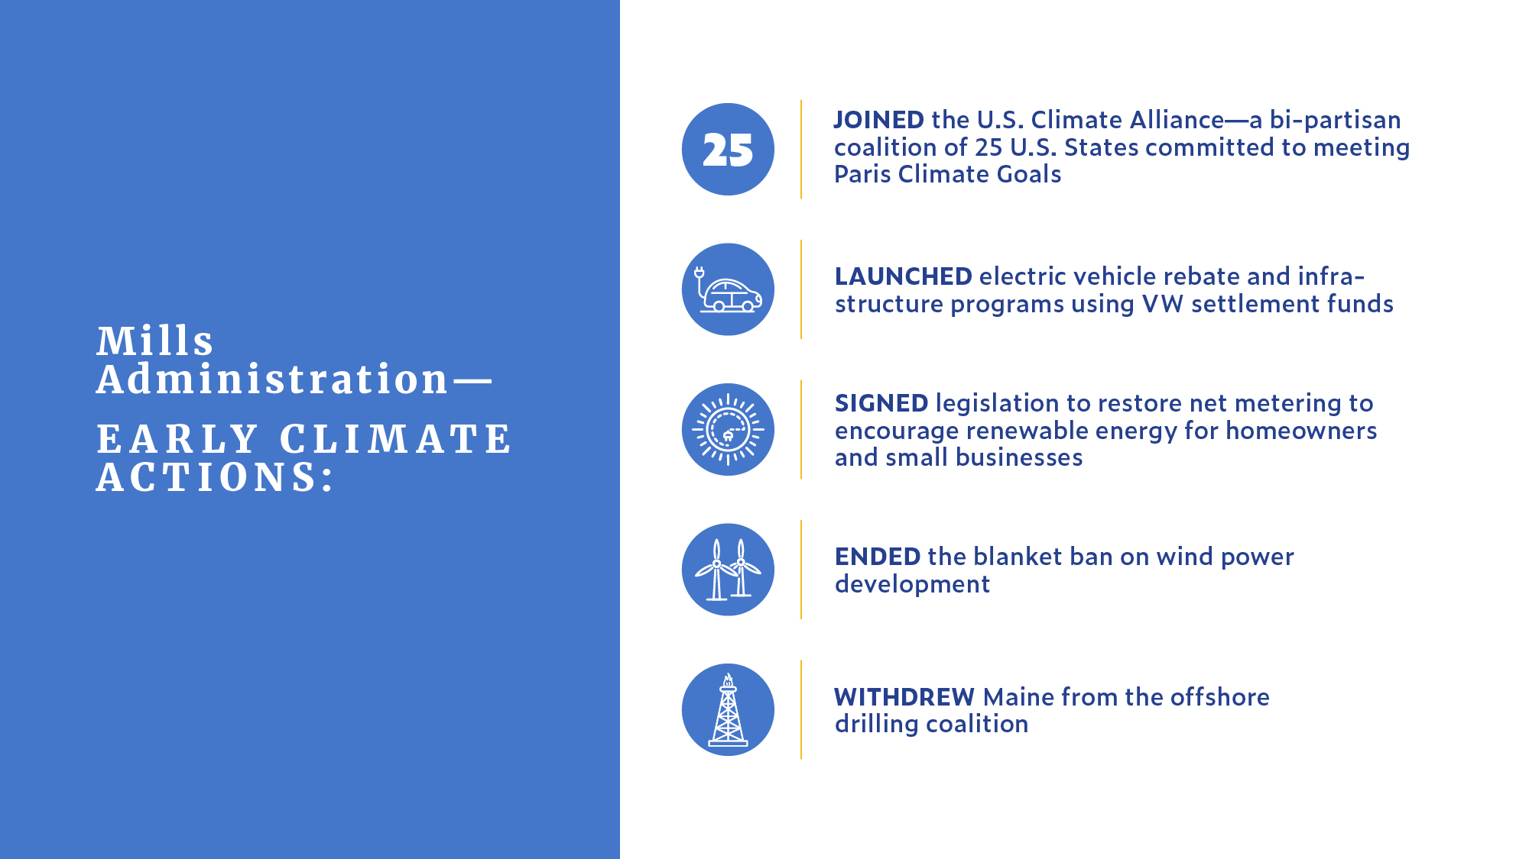

Slide 5
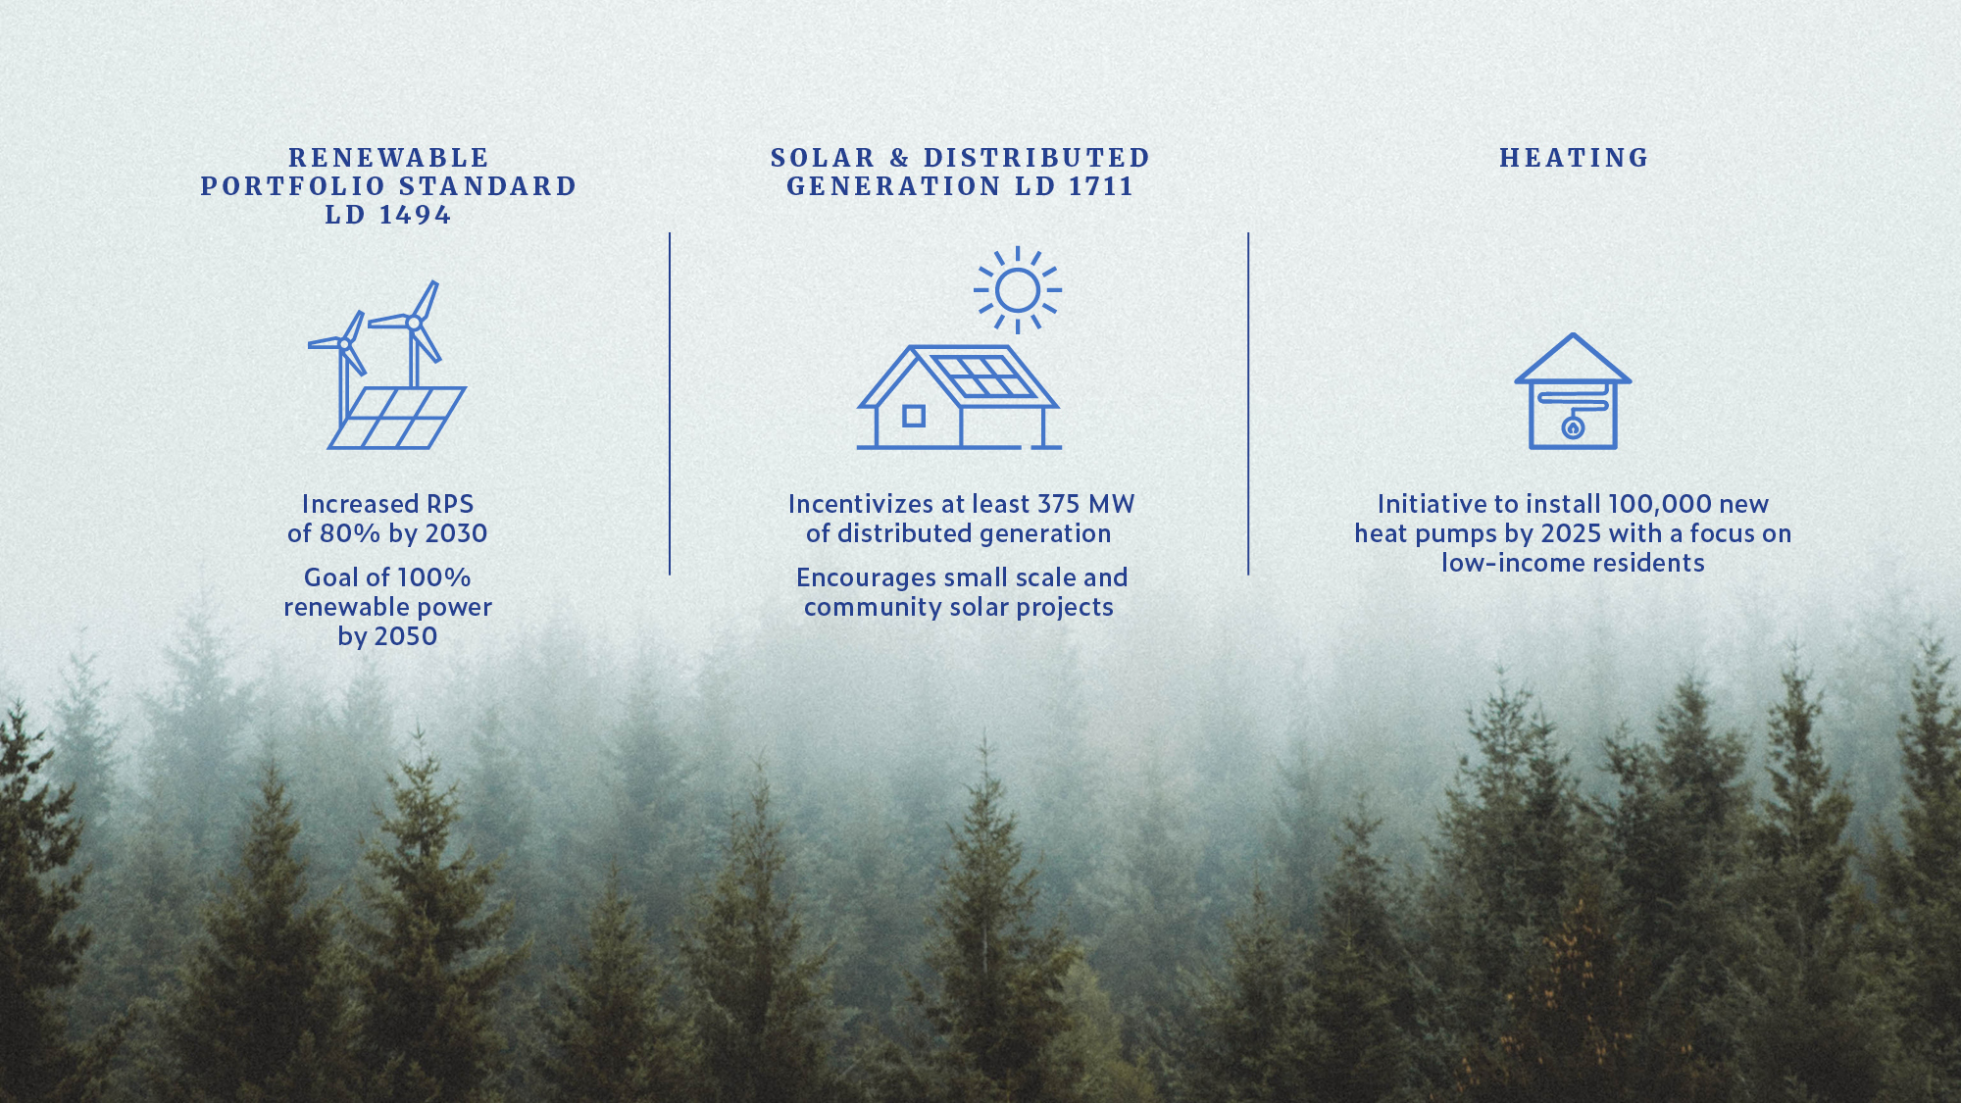

Slide 6


WHAT IS THE MAINE CLIMATE COUNCIL?
Notes:
MCC established in 2019 through bipartisan legislation
Tasked with producing a statewide climate action plan every 4 years

Slide 7
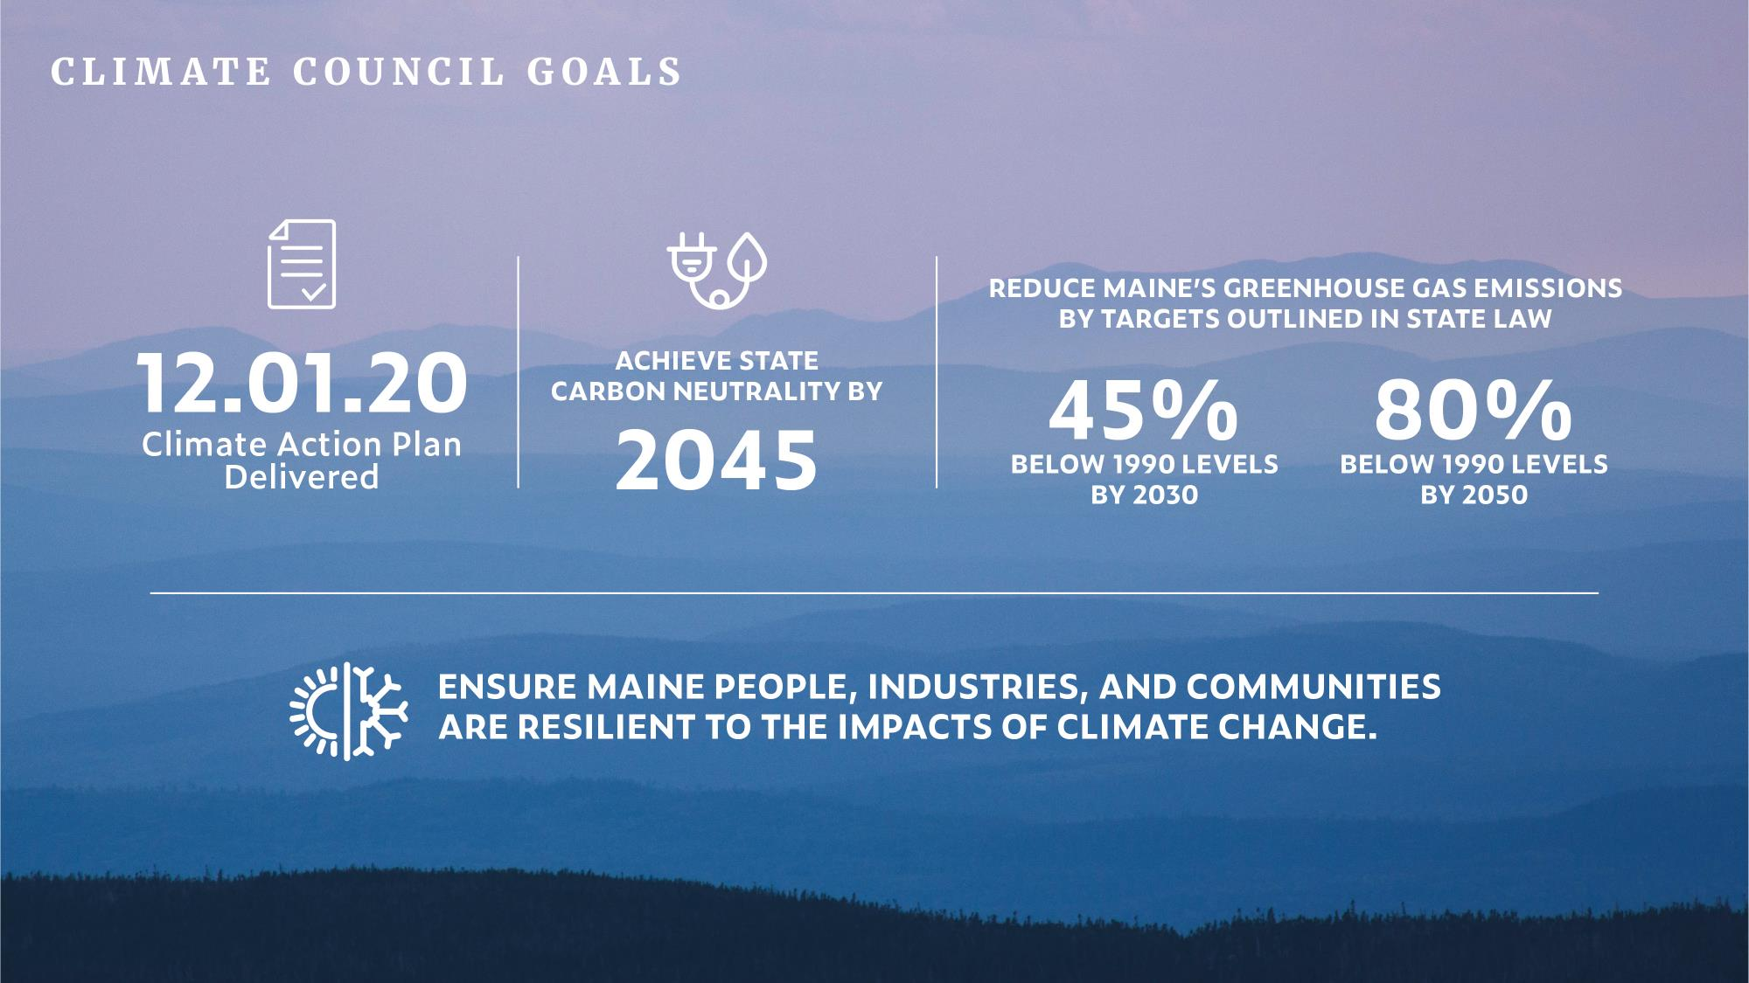
Notes:
The same legislation established two ambitious GHG reduction targets
And instructions to ensure the state also builds resilience to impacts of CC
The MCC is charged with developing the plan to meet these targets and goals.
The first plan is due this December 1st.

Slide 8








The 39-member Maine Climate Council, an assembly of scientists, industry leaders, bipartisan local and state officials, is responsible for developing a
Climate Action Plan for Maine.
Six working groups comprised of 230+ volunteer members recommend strategies to the Council for achieving Maine's climate goals.
An expert Scientific and Technical Subcommittee is responsible for identifying the impacts of climate change in Maine.
Maine
Climate Council
Transportation
Buildings,
Infrastructure,
& Housing
Energy
Scientific & Technical
Subcommittee
Community Resilience Planning,
Public Health, &
Emergency Management
Natural &
Working Lands
Coastal & Marine

Slide 9

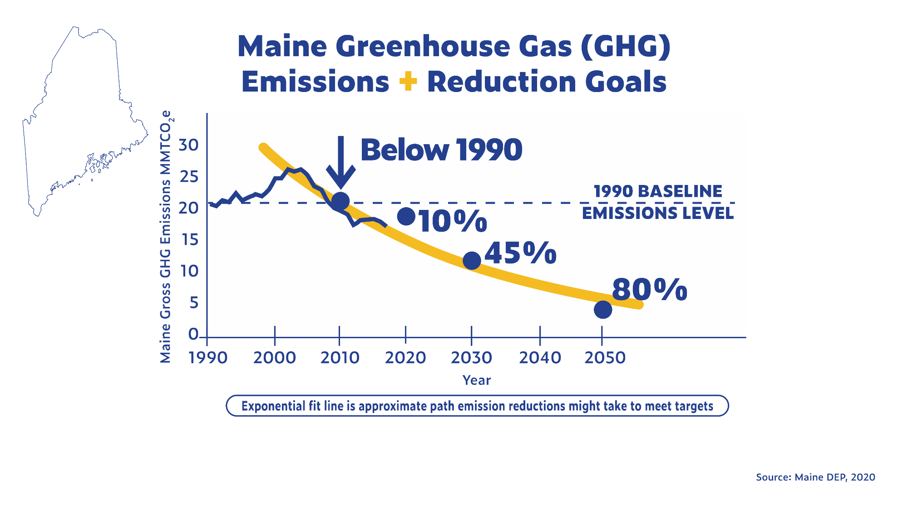
Gap betw. 2050 goal &
long-term GHG trend
Notes:
The task is daunting but progress has already been made:
Blue line: Maine’s GHG emissions peaked in 2002
down 33% from peak as of 2017 data
Currently 17% below 1990 level
meeting interim goal of 10% by 2020
Need to keep tracking on or below the yellow line

Slide 10
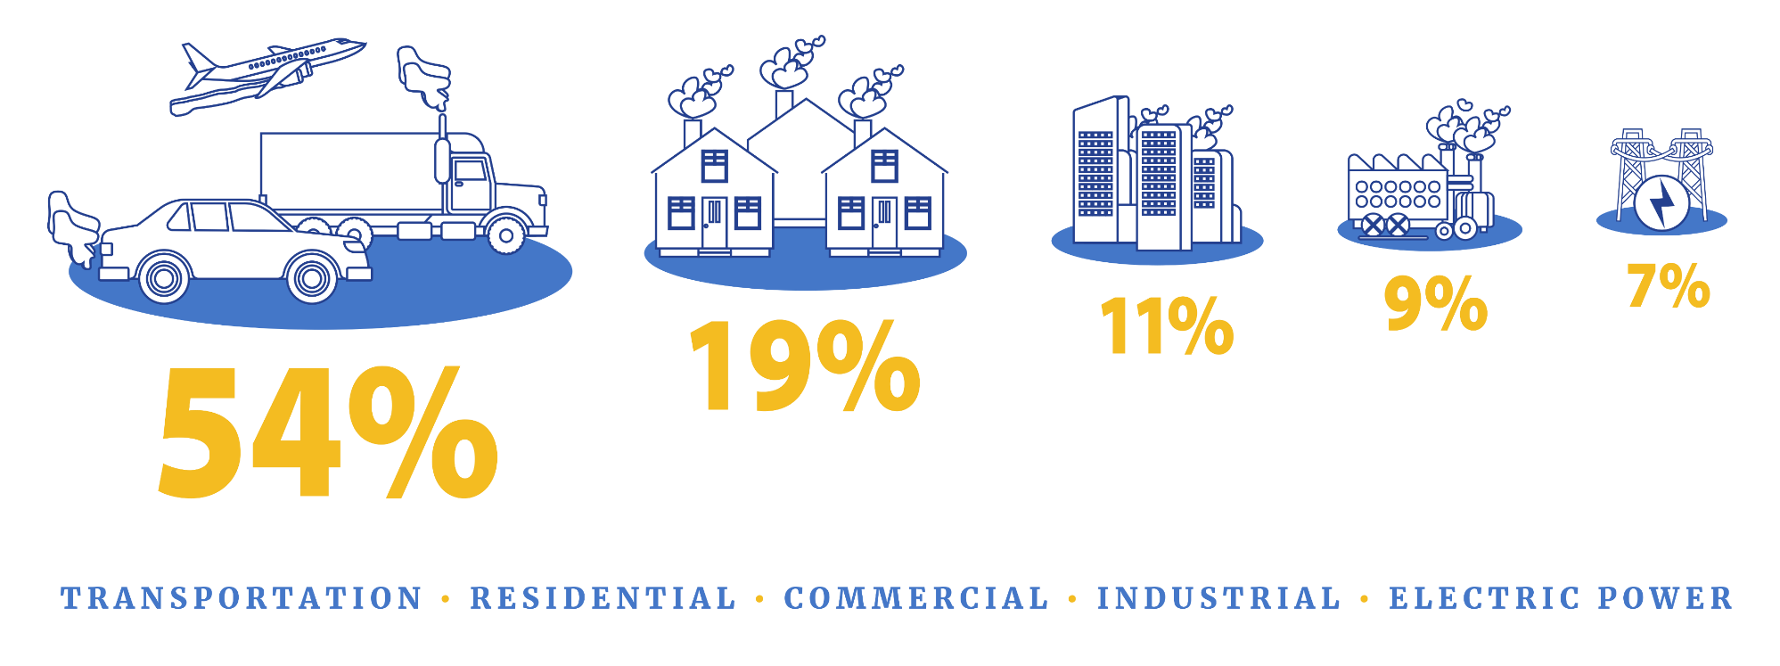
In Maine, most greenhouse emissions come from transportation, followed by residential, commercial and industrial sources. Finding ways to reduce them is a key goal of the Climate Council.
Data source: Maine Department of Environmental Protection 8th Biennial Greenhouse Gas Emissions Report
climatecouncil.maine.gov
Notes:
¾ of GHG emissions from transp and building heating
In a moment you will see that a number of proposed strategies aim to reducing reliance on combustion of fossil fuels through efficiency and weatherization, and by electrifying transp and building heating

Slide 11
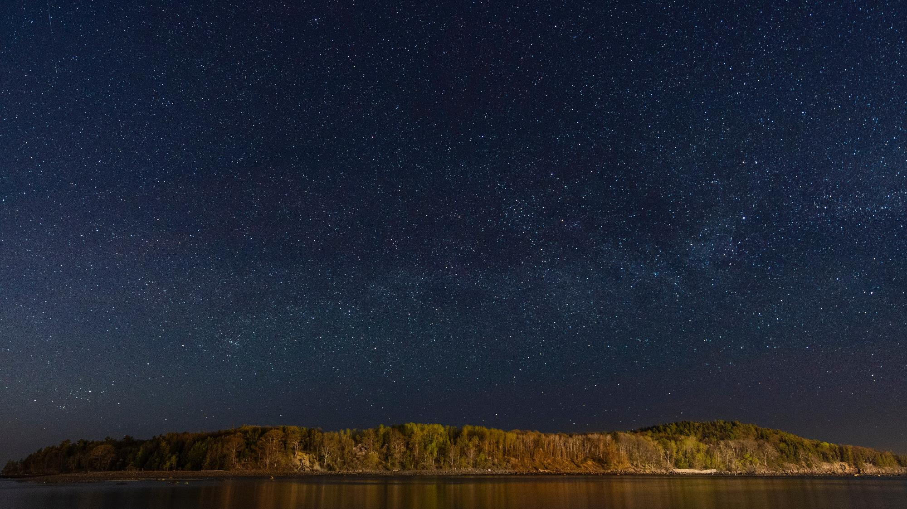
Climate Council Guiding Principles
IMPROVE the resilience of Maine’s communities, people, and industries to climate impacts
PRIORITIZE the welfare of Maine citizens—especially the most vulnerable communities
FOSTER the value of the State’s natural resources and natural resource industries
ENCOURAGE diversity, inclusion and equity of all Maine communities and people
UTILIZE the most recent scientific and technical information and measure progress
Notes:
In addition to the emissions goals,
the legislation provides the Council with guiding principles
for addressing resilience, vulnerable communities, natural resources, equity, and the use of sound-science in its deliberations

Slide 12
Maine Climate Council Goals
Goal 1: Create jobs and economic opportunity
Goal 2: Reduce Maine's greenhouse gas emissions
Goal 3: Prepare Maine residents, businesses and communities for climate change impacts
Goal 4: Ensure that Maine’s climate strategies are equitable

Slide 13
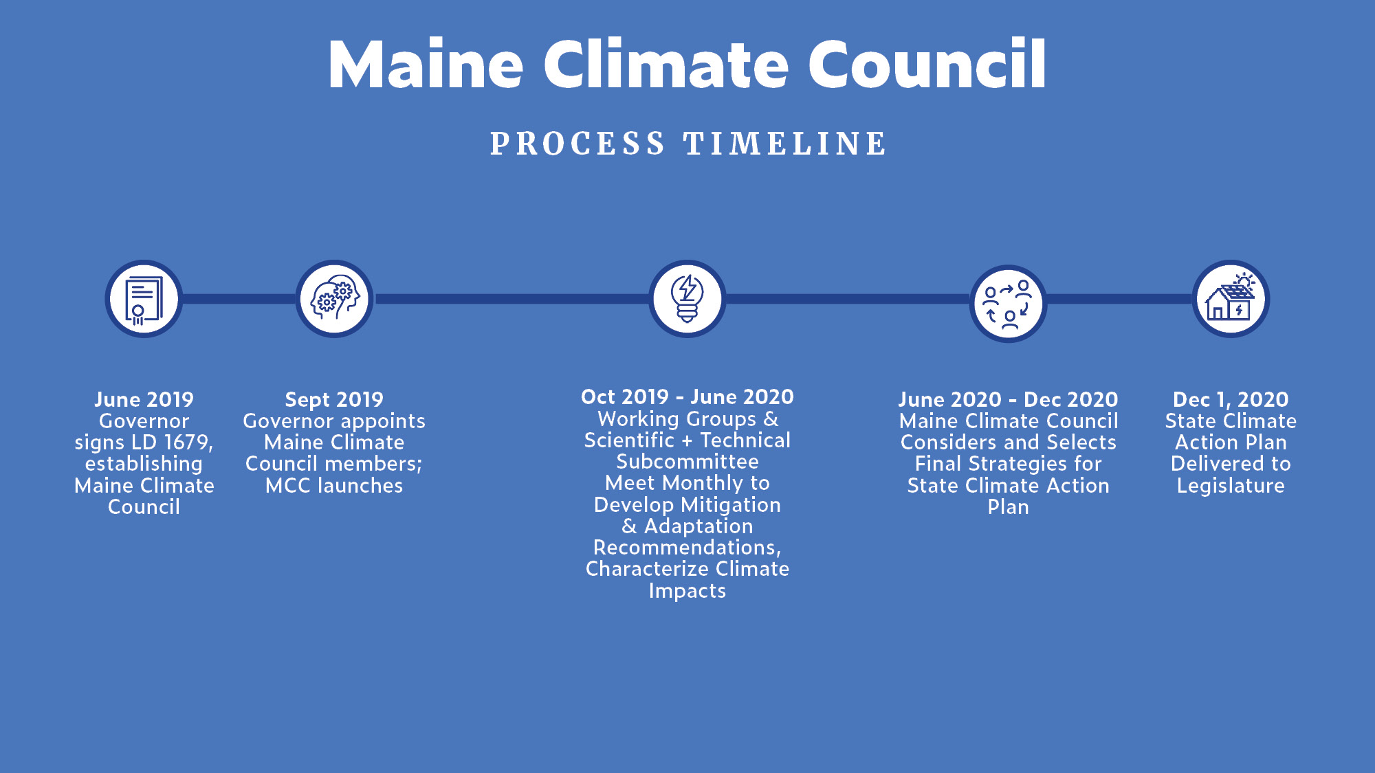
Notes:
Summer 2020
-Stakeholder engagement & Public outreach
-Economic analyses: CBA, CODN, vulnerability mapping, emissions modelling
-Equity assessment
--provide the Council with additional context for deliberations this fall

Slide 14
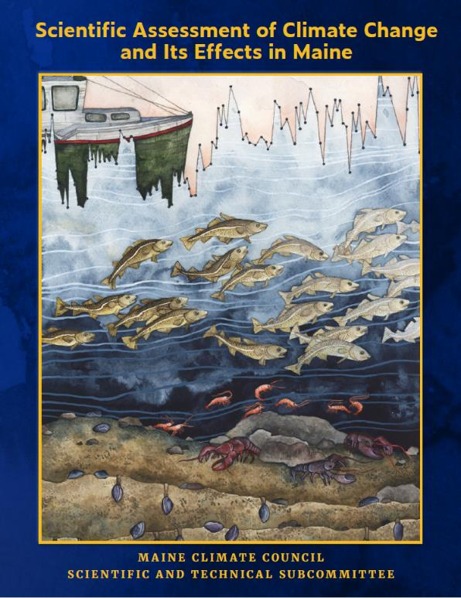

Maine Climate Council Reports
The STS recommends that the Maine Climate Council consider committing to manage for 1.5 feet of relative sea level rise by 2050, and 3.9 feet of sea level rise by the year 2100.
Additionally, the STS recommends that the Climate Council consider preparing to manage for 3.0 feet of relative sea level rise by 2050, and 8.8 feet of sea level rise by the year 2100.

Slide 15
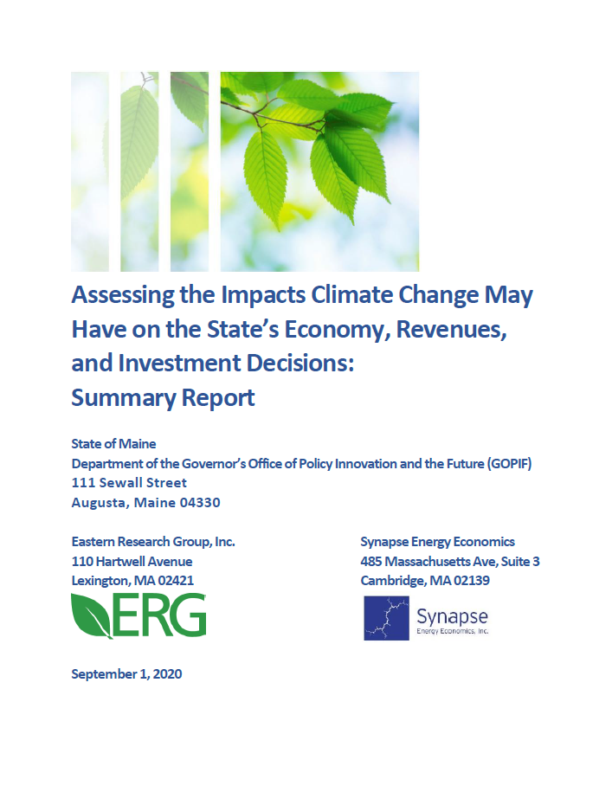
Maine Climate Council Reports
Cost-Benefit Analysis
Volume 1: Vulnerability Mapping
Volume 2: Cost of Doing Nothing
Volume 3: Greenhouse Gas Modeling
Volume 4: Economic Analysis
Equity Assessment
And Still Coming: Clean Energy Economy Report

Slide 16
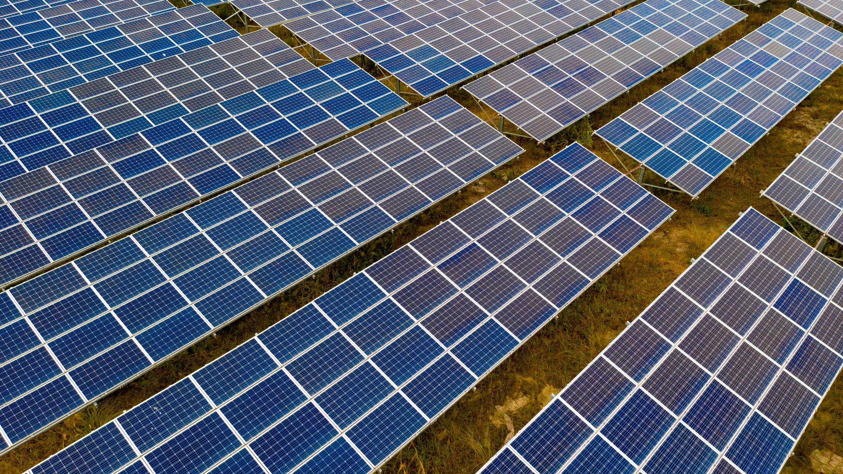
Reduce Maine’s Greenhouse Gas Emissions
Bring the Future of Transportation to Maine | Modernize Maine's Buildings | Reduce Carbon Emissions in Maine’s Energy and Industrial Sectors
Increase electric vehicle use Reduce emissions from current gas and diesel engines Reduce Vehicle Miles Traveled (VMT) Explore funding options for transportation needs & emissions reductions | Improve the design and construction of new buildings and improve the efficiency of existing buildings Promote climate-friendly building products Transition to cleaner heating and cooling systems Institute a Renewable Fuel Standard “Lead by Example” at state and local level | Ensure adequate affordable clean energy supply Initiate a stakeholder process to modernize Maine’s electric grid Accelerate the decarbonization of industrial use and processes Encourage highly efficient Combined Heat and Power facilities Develop financing options to meet clean energy and emission reduction targets
Notes:
Themes:
Using less energy through efficiency
Electrification of heating and transportation
Cleaning the energy sources feeding the grid

Slide 17
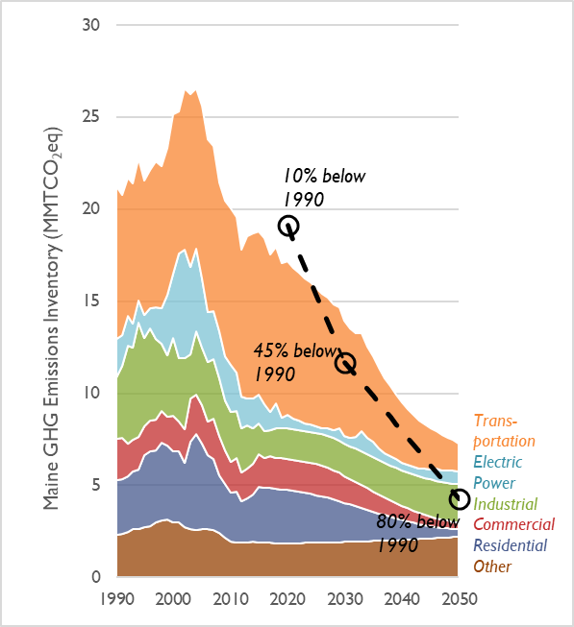
Potential Decarbonization Policies and Future Maine Emissions
Emissions are projected to decline through 2050
Total emissions in 2050 are 7.3 million metric tons, which is 3 million metric tons above the 2050 target
By 2050, the largest remaining sources of emissions are the industrial and other sectors, which were not modeled in depth
Air travel makes up a large portion of remaining transportation emissions
Modeled future greenhouse gas emissions from Maine’s various sectors and statutory goals (dashed line).
Notes:
Modeling was performed for the three primary energy sectors: transportation, buildings, and electric.
Transportation Sector – EV-REDI (Electric Vehicle Regional Emissions and Demand Impacts)
Buildings Sector – Building Decarbonization Calculator (BDC)
Electric Sector – EnCompass (New England Grid)
Modeling was performed for a sustained policy scenario and alternative scenarios for each of the three energy sectors.
The sustained policy scenarios for each sector were based on existing policies and represent the baseline or business as usual scenario.
The policy scenarios explored varying degrees of beneficial electrification, reducing vehicle miles traveled, efficiency gains, displacement of traditional fuels with low-carbon fuels, and renewable energy policy goals

Slide 18



Prepare for Climate Change Impacts
Build Healthy and Resilient Communities | Invest in Climate-Ready Infrastructure | Protect Maine’s Environment and Natural Resource Economies and Promote Natural Climate Solutions
Enhance and coordinate assistance and funding for community resilience Improve the planning and legal tools that build resilience Invest in public health monitoring and education Protect water sources from high intensity weather events | Assess the vulnerability of Maine’s infrastructure Provide technical assistance and seed funding to unlock federal funding for infrastructure projects Give particular to Maine’s working waterfronts and seaports | Protect Maine’s natural and working lands and waters Support Maine’s natural resource economies – especially our farms, forest sector, and seafood harvesters Increase carbon sequestration Improve monitoring to understand and manage the response to climate change
Notes:
Three adaptation-focused groups
Themes:
science & monitoring,
technical assistance,
nature-based solutions,
updating state laws and programs
Across all 6 WGs, other cross-cutting themes
Funding, innovative financing, incentives
Workforce development opportunities
Education & awareness building

Slide 19

What’s Next?
October 1: Next Maine Climate Council Meeting
and continues to meet all Fall
December 1: 4-Year Action Plan
Delivered to Governor and Legislature
Maine Climate Council continues to
meet quarterly to monitor progress

Slide 20

The council works for all of Maine. All of Maine has a voice in our recommendations.
ClimateCouncil.maine.gov

Slide 21
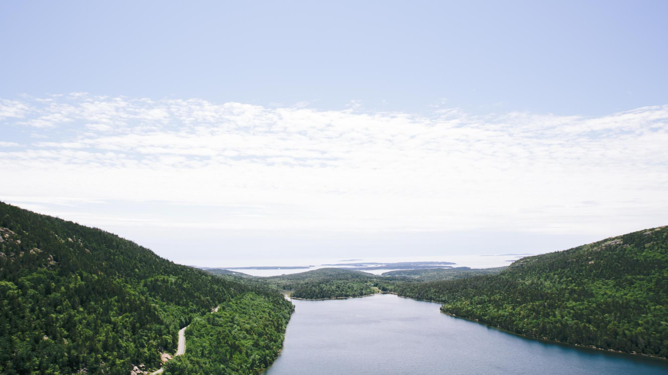
Thank you!
Questions?

